Slide 1
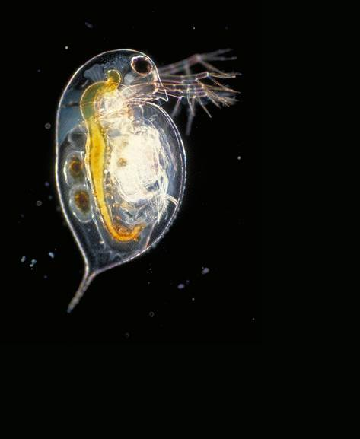
The effect of genotypic diversity on evolution under copper stress in Daphnia pulex and Daphnia pulicaria
PIUMI ABEYNAYAKA
SUPERVISORS: GREGOR FUSSMANN AND MELANIA CRISTESCU

Slide 2
Collaborators
SARAH FINLAYSON
ALESSANDRA LORIA
THOMAS INGALLS
GENELLE HARRISON
TIFFANY CHIN

Slide 3
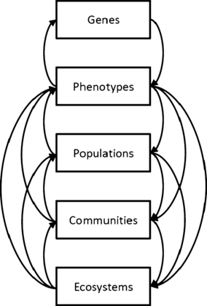
Intra-specific diversity
-can fuel adaptation on contemporary timescales
-adaptation shapes survival and adaptation rates → ecological effects
Eg. Clonal diversity affects predator-prey oscillations in rotifer-algae system [Yoshida et al. (2003) Nature]
Parasite resistance in Daphnia populations [Altermatt and Ebert (2008) Ecology Letters]
Bailey et al. (2009) New Phytologist
Notes:
Conceptual model of dynamic eco‐evolutionary feedbacks, demonstrating the potential feedbacks from genes to phenotypes across population, community and ecosystem levels of organization.
© This slide is made available for non-commercial use only. Please note that permission may be required for re-use of images in which the copyright is owned by a third party.

Slide 4
Hypotheses
Does genotypic diversity influence the size and growth rate of Daphnia populations, especially when evolving under copper stress?
Higher diversity will enhance population growth and size, regardless of copper stress.
Higher diversity will aid in adaptation to copper stress, thereby buffering population growth.

Slide 5
Toxicity tests
Preliminary issues:
Determine whether pond and lake Daphnia differ significantly in their copper tolerances.
Determine a copper concentration for use in the experiment: should yield ~10% mortality of lines per habitat.

Slide 6
Acute toxicity test:
Design
21 habitats: 9 lakes, 12 ponds
2 lines per habitat
2 replicates per line
8 Cu concentrations
  A no copper control + 7
  5 neonates per concentration
Eg. Solomon Pond
Habitat
2
Clone line
1
Replicate
a
b
a
b
x 5 neonates
0 150 156 162 168 174 180 186
µg Cu/ L

Slide 7
Acute toxicity test:
Analysis
LC50 and LC10 via GLM with binomial distribution and probit link in R [(Kerr and Meador (1996) Environ Toxicol Chem]
Welch’s two-sample t-test: ponds vs lakes
MANOVA: differences between habitats
Eg. Solomon Pond
Habitat
2
Clone line
1
Replicate
a
b
a
b
x 5 neonates
0 150 156 162 168 174 180 186
µg Cu/ L

Slide 8
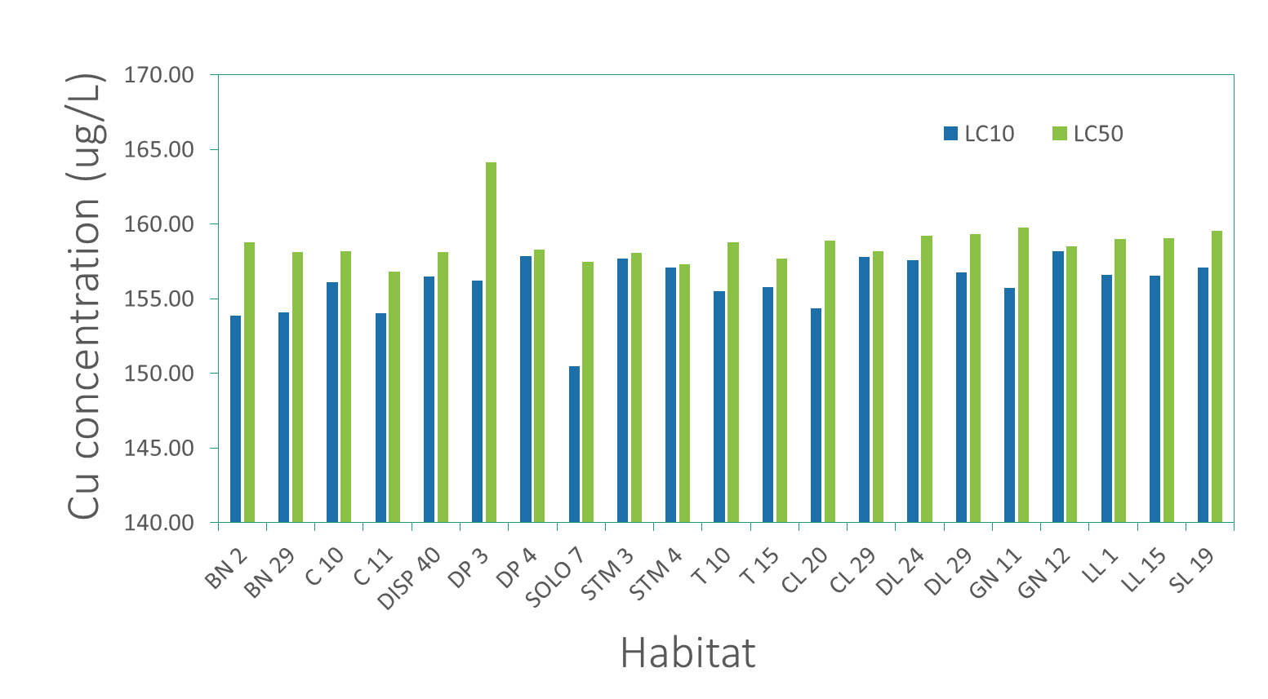
Acute toxicity test:
Results
Welch’s t-test: p > 0.05 for both LC50 and LC10
MANOVA: p > 0.05
Mean LC50 = 158.7344 ug Cu/L
Mean LC10 = 156.01 ug Cu/L

Slide 9
Experimental design:
Tank Set-up
 | No diversity (monoculture) |  |  | Low diversity |  |  | High diversity
 | Tank pair 1 | Tank pair 2 | Tank pair 3 | Tank pair 4 | Tank pair 5 | Tank pair 6 | Tank pair 7 | Tank pair 8 | Tank pair 9
No copper | A | B | C | ABC + DEF | ABC + GHI | ABC + JKL | A-L (12) + M-X (12) | A-L + Y-JJ (12) | A-L + KK-UU (12)
Copper | A | B | C | ABC + DEF | ABC + GHI | ABC + JKL | A-L (12) + M-X (12) | A-L + Y-JJ (12) | A-L + KK-UU (12)

Slide 10
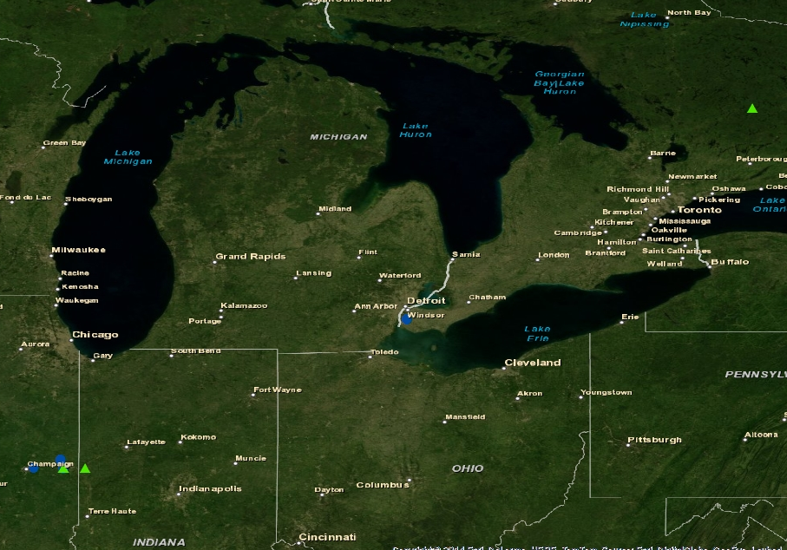
Experimental Design:
Choosing lines
10 habitats: 5 lakes and 5 ponds
Random selection of 48 lines
-15 lines from tox test
-3 tox test lines assigned to monocultures
-low div lines selected randomly from among 48

Slide 11
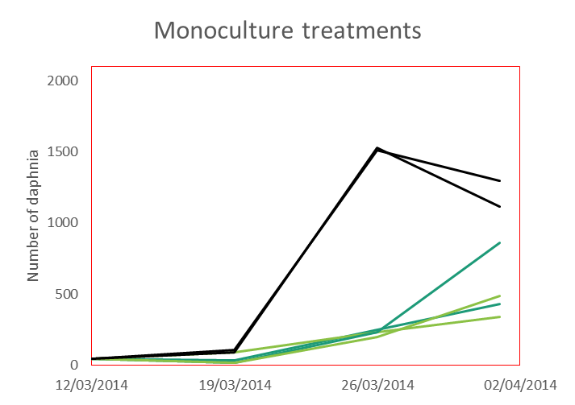
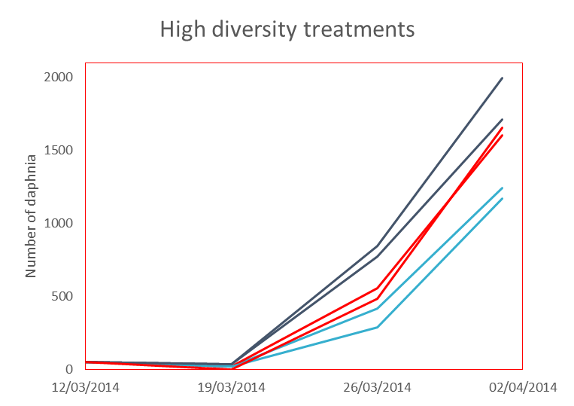
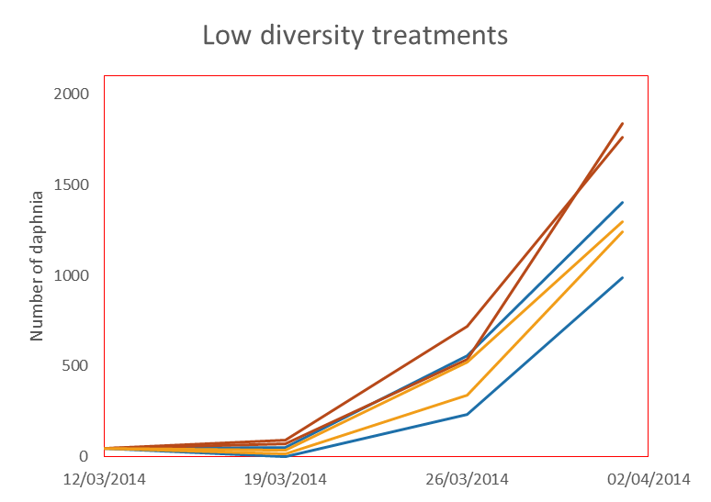
Data so far…
Do paired tanks differ?
Paired t-tests: p > 0.05 for both responses
Do the diversity treatments differ in average population size and growth rate (as measured by r)?
MANOVA: p = 0.01837 for Treatment; p < 0.01 for both responses with ANOVA

Slide 12
Conclusions
The range of Cu tolerance is very narrow and lacks variation between clonal lines.
Genotypic diversity levels do affect population size and growth rate.
Future Directions and Remaining Questions
Copper stress
  Will diversity interact with copper stress?
Genetic analysis
  How do copper stress and environment interact to influence allelic frequency over time?

